Slide 1
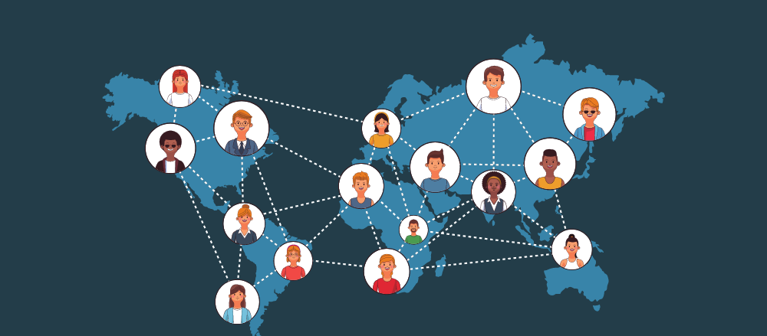
Social Media Network Analysis

Slide 2
Key techniques used
Graph construction
Centrality Metrics
Community Detection

Slide 3
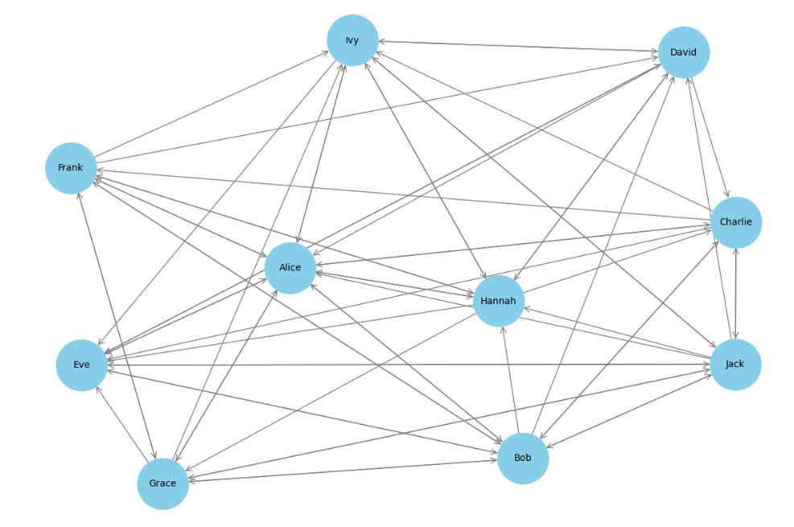
Graph

Slide 4
Results
Identified Influencers
Community structure

